Slide 1

VIDEO CHATTING WEBSITE
(Let’s Talk)
By
Akshat Mehta
Bansari Vora
Harsh Shah
Sparsh Shah

Slide 2
Table of contents
Abstract
Introduction
Existing method
Proposed methodology with architecture
Implementation
Conclusion

Slide 3
Abstract
Video calling has become an integral part of our day-to-day life for establishment of communication. Be it Business Meetings, Online Lectures, Hanging Out with friends etc. Video Calling is in demand for each and everything. Video Calling has recently gained immense popularity due to this pandemic. Taking this immense growth into consideration, the progress of video technology, video communication is gradually changed from point-to-point to multipoint-to-multipoint, from standard image to high-definition image, from one-way transmission to two-way transmission.

Slide 4
Introduction
In business sectors, to avoid face to face contact video conferencing technologies play an important role. Meetings, briefs and collaborative idea-sharing still take place, even when the office staffs aren’t in the same room.
In education industry video calling is widely used inside and outside the classrooms. Nowadays, due to pandemic institutes have to totally rely on these technologies.
We can connect to our friends, family who stay apart from us.
The goal of our project is to build the video calling website that enables user to connect other user in real-time by streaming video and also user can chat during the video call session and share their live video to other user in the chat room.

Slide 5
Existing methods
Omegle is one of the most well-known random video chat sites. This online chat website caters to people that want to have a conversation with total strangers.
Fruzo-Fruzo is an online video chatting platform that allows users to connect with people through their Facebook accounts or create a new profile to use this network.
Faceflow platform has transformed social networking totally; users can video chat with about three people simultaneously straight up from your internet browser.
Tinychat-Tinychat is a random video call site where you can easily create a conference call with several people at the same time.
Younow-Younow is one of the unique video chat websites becausein this the premium users can create and host their chatrooms, and other users can join and interact with each other.

Slide 6
Proposed Methodology with architecture
Let’s talk is created using HTML, CSS, JAVASCRIPT and NODE JS with some essential libraries namely: Socket.io which consists of the Node. Js server: Source | API, WebRTC which consists of various Java Script APIs etc.
HTML and CSS is used for creating the GUI for the Web Site.
The user enters the required fields which are the User Name and the Room Name in the given input fields and clicks the Create Room button for generation of a unique Room Link which is basically a Random String generated through the Java Script.
When the Room Link is generated, the user can share the following link to other users who wish to be added to the Room.
When the invited user clicks on the Room Link shared by the Owner, the user needs to enter their name and click the Enter Room button,all this connection establishment and linking is done with the help of Socket.io and WebRTC.

Slide 7
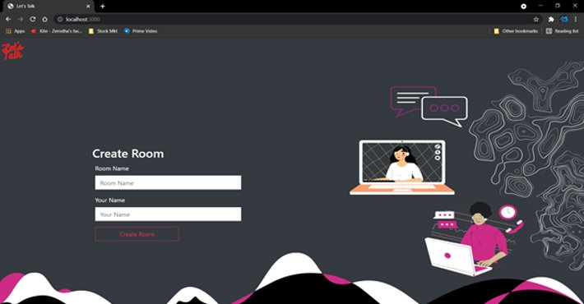
Implementation
The Main Screen-

Slide 8
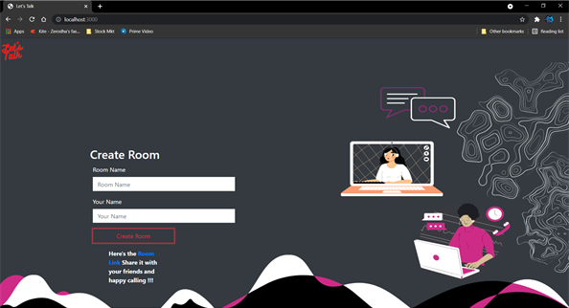
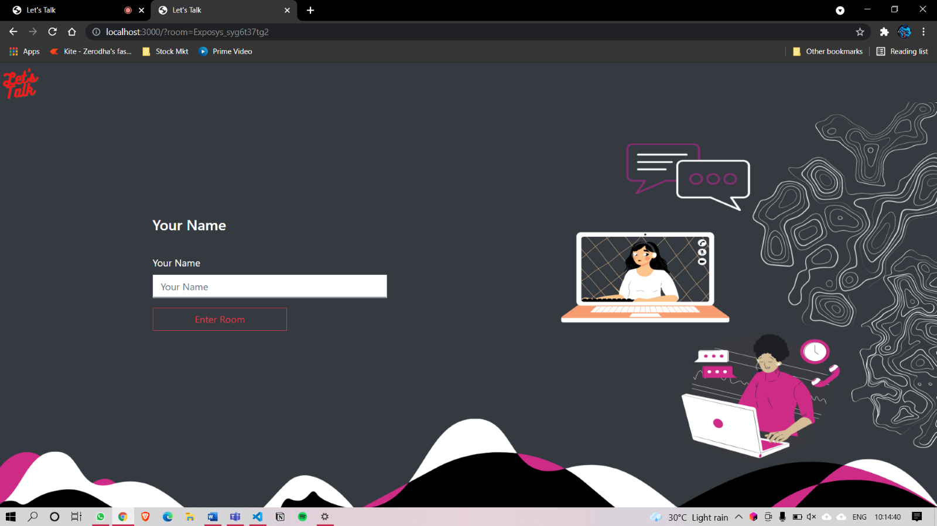
Once the User enters the necessary details the room link is generated-
The Invited users screen-

Slide 9
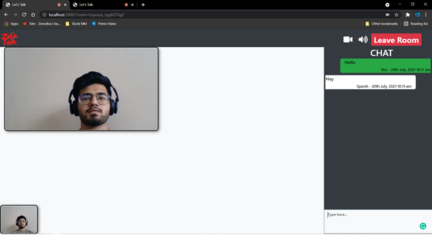
The Room Screen -

Slide 10
Conclusion
This project is entitled as Let’s Talk - A video calling web application. Though many difficulties were faced during the project as well as many errors occurred, we became succeed to compile and run the program.This project can be experimented in future by adding more features to it. As well as, we are more hopeful for more advice, new ideas and inspiration to make more improvisation to our project.We have tried our best to include each and every basic feature of web development in our project.From this project we were able to achieve various knowledge not only in web development but also in logical coding. Moreover, we also gained an experience of group work, team coordination. We learned how team work is very much important in corporate world.

Slide 11
Thank You!

